Slide 1
EARLY
UTILITY
ACCOMMODATION
Jennifer McCleve, PE
Utilities and Rail Branch Manager
Kentucky Transportation Cabinet
jennifer.mccleve@ky.gov

Slide 2
Early Utility Accommodation Outline
What is EUA?
What law allows for EUA?
EUA Process
Advice and Tips

Slide 3
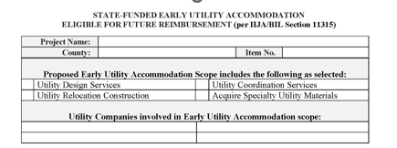
What is Early Utility Accommodation (EUA)?
Utility Design Services
Utility Coordination Services
Utility Relocation Construction*
Acquiring Specialty Utility Materials*

Slide 4
What is Early Utility Accommodation (EUA)?
Reimbursable utility Relocations may take place early
Prior to NEPA
They may be reimbursed using state funds
Kentucky may seek federal reimbursement for the cost once the transportation project is approved for construction
The Utility relocation must have its own environmental review completed and it must confirm…
No significant adverse environmental impacts.
Compliance with any environmental requirements, law, regulations, statutes, policies, etc.
Does not impact the transportation project’s environmental review process
Does not factor into the need to construct the transportation project or the project’s design.

Slide 5
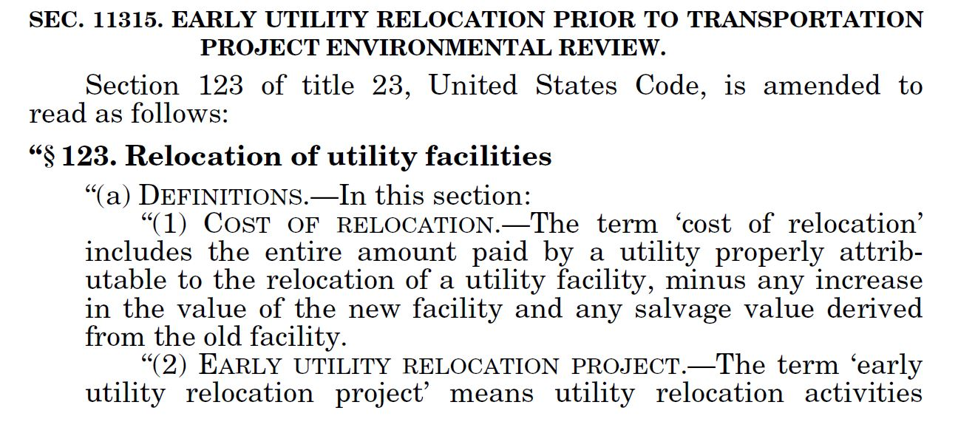
What Law allows for EUA?
Infrastructure Investment & Jobs Act (IIJA), Sect 11315
23 USC Section 123 (Amended)

Slide 6
What Law allows for Early Utility Accommodation (EUA)?
23 USC 123 now operates similar to Early ROW Acquisition
Kentucky is one of the first states to implement

Slide 7
IIJA Criteria
Title 23 eligible
Kentucky’s/local transportation improvement program (STIP) and/or the regional/local transportation improvement program (TIP).
Not a LPA project
The EUA Scope must…
RESEARCH
DESIGN
Cause no significant adverse environmental impacts to the project.
Not impact critical and costly environmental features.
Be required to accommodate the transportation project.
Comply with KYTC and federal policy, law, regulation.
KENTUCKY TRANSPORTATION CENTER

Slide 8
Early Utilities (EU) Task Force
Task force created minimum EUA criteria & process
Task force comprised of KYTC representation from:
Planning
Design
Environmental
Program Management
ROW
Utilities

Slide 9
Early Utilities (EU) Task Force
Recommended Criteria for IIJA EUA Implementation
Identified Kentucky’s EUA scope items:
Utility Design
Utility Coordination
Utility Relocation Construction (In IIJA)
Utility Materials

Slide 10
Task Force: Recommendations for EU Projects:
Unavoidable utility relocations.
Take an extensive time to design construct or secure materials.
Large scale facilities (i.e. buildings, pump stations, treatment facilities).
Preferred relocations on existing ROW
Not in historic districts
RESEARCH
ABSTRACT
DESIGN
KENTUCKY TRANSPORTATION CENTER

Slide 11
Task Force: Project Types Benefiting from EUA may …
Be a priority project
Have a firm deadline to construct
Have a firm/set alignment
New corridors, roadways with a big utility
No critical environmental features
RESEARCH
ABSTRACT
DESIGN
KENTUCKY TRANSPORTATION CENTER

Slide 12
Task Force: Utility Design & Utility Coordination Criteria
Preferred to use a state funded EU phase.
Alternative: Design phase funds may be used if the budget allows and no EU relocation or material acquisition is included in the EU.
If the EU scope includes ROW/Replacement Easement
If KYTC is acquiring the replacement easement it must be transferred to the utility company once complete.
KYTC must implement early ROW acquisition and acquire
Necessary ROW parcels (by KYTC)
Replacement easement (through utility company or KYTC)
If a parcel includes both they should be acquired in a single acquisition (by KYTC)
If the company is acquiring the replacement easement and are eligible to condemn, the agreement shall require the utility to condemn.
ABSTRACT
DESIGN
KENTUCKY TRANSPORTATION CENTER

Slide 13
Task Force: Utility Relocation Criteria
Must use a state funded EU phase.
Environmental approvals for utility work shall be…
Utility provided (in house or approved consultant) or KYTC consultant provided
Supplied to project team including the DEA for inspection
Supplied to FHWA when seeking federal participation
Field and plan changes must be communicated to DEA and managed by the utility environmental coordinator and documented in as built plans.
RESEARCH
ABSTRACT
DESIGN
KENTUCKY TRANSPORTATION CENTER

Slide 14
Task Force: Utility Materials Acquisition
Must use a state funded EU phase.
Materials to be acquired via EU must be documented to adhere to at least one of the following
In limited supply.
Anticipated to increase in cost by more than 20% before a standard utility agreement would be available.
Require a long lead time to acquire, 6 months or more.
In high demand and likely to become unavailable prior to construction and /or.
Required extensive engineering or specially design pieces.
RESEARCH
ABSTRACT
KENTUCKY TRANSPORTATION CENTER

Slide 15
Any restocking fees or penalties must be addressed in the agreement between KYTC and the utility company. These should be carefully considered when determining viability of EU materials acquisition.
Materials are preferred to be delivered directly on the project site in tandem with the construction work.
If not viable, material storage location and standards to be included in the agreement between KYTC and the utility company. Liability of damages and material inspection criteria must be clear.
Delivered EU materials may be stored by the utility company (preferred) or by KYTC. If KYTC stores, the utility company shall inspect the material upon delivery and once again when on the project site. KYTC liability for damages shall be minimized when possible.
RESEARCH
ABSTRACT
DESIGN
KENTUCKY TRANSPORTATION CENTER

Slide 16
PROCESS FOR EUA

Slide 17
Utility Design
Utility Coordination
Utility Relocation
Utility Materials
Consider EUA during planning or phase 1 design
(preferably prior to PLG)
RESEARCH
ABSTRACT
DESIGN
Utility Coordinator must seek concurrence with utility company

Slide 18
The Team shall…
Confirm the project and utility Impacts
Consider environmental impacts
Estimate the budget
RESEARCH
ABSTRACT
DESIGN

Slide 19
The utility coordinator shall complete the EUA Form.
Ensure ability to comply with terms and conditions of the form
Ensure compliance with the policies.
Validate no interference with elements of the project including NEPA.
RESEARCH
ABSTRACT
DESIGN

Slide 20
The Utility Coordinator shall submit the EUA Form and supporting documentation to the U&R Branch.
Approvers:
Project Development Branch Manager
District Utility Supervisor
Utility Company
Director of Environmental Analysis
Director of Right of Way and Utilities
Programs Management
ABSTRACT
KENTUCKY TRANSPORTATION CENTER

Slide 21
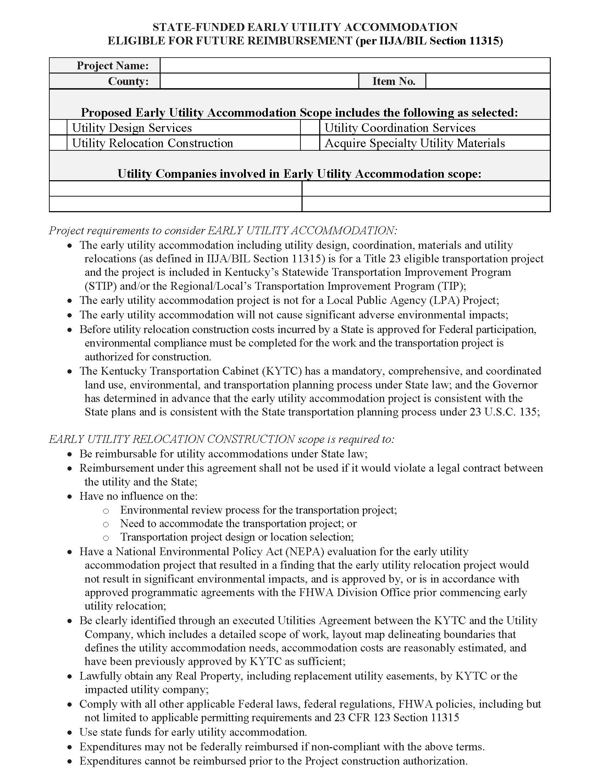
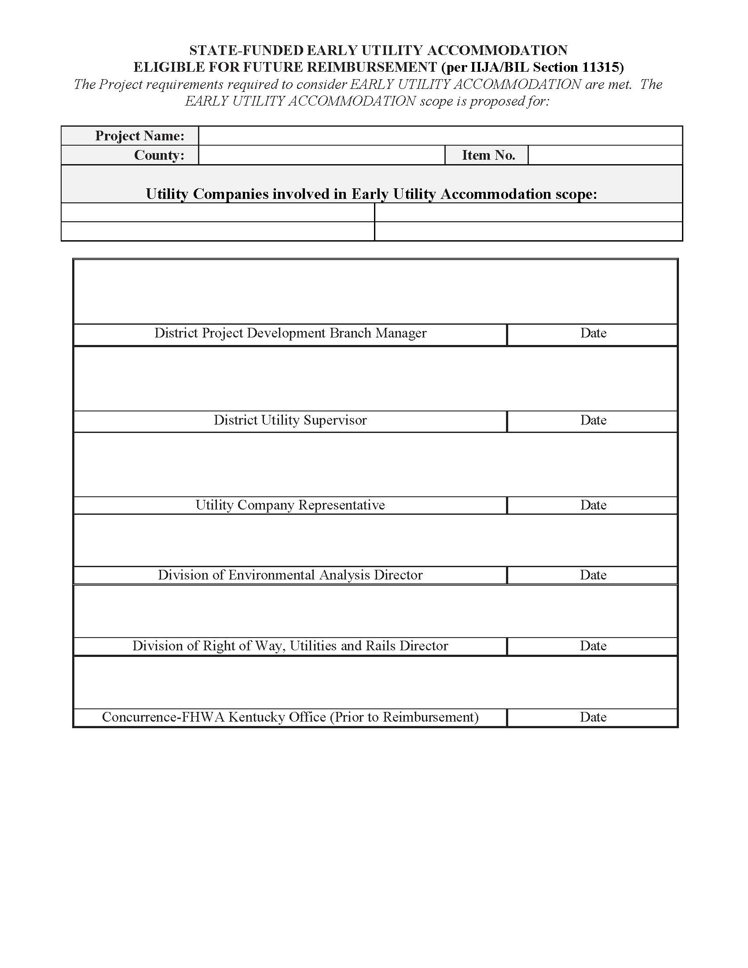

Slide 22
KYTC APPROVED EUAs
Sent to FHWA Kentucky Division Office for FHWA Review and approval.
If EU Phase is needed, FULLY APPROVED EUAs are sent to Division of Program Management for funding.
RESEARCH
ABSTRACT
DESIGN

Slide 23
Once funded the EUA can begin…
Utility Design
Estimates, design agreements, consultant approvals, oversight.
Utility Coordination
Conflict and resolution planning, Utility Design tasks, relocation agreements, Replacement easements and acquisition.
Utility Relocation
Utility Coordination tasks, construction planning, NEPA approval for utility work (utility provided and KYTC reimbursed), and inspection.
Utility Materials
Estimate, materials contracting.
RESEARCH
ABSTRACT
DESIGN
KENTUCKY TRANSPORTATION CENTER

Slide 24
Before costs incurred are approved for Federal Participation.
FHWA must receive the utility environmental evaluation and necessary documentation.
Transportation project must be authorized for construction.
Detailed and itemized cost documentation must be provided.
RESEARCH
ABSTRACT
DESIGN
KENTUCKY TRANSPORTATION CENTER

Slide 25
If EU scope used EU Phase Funds and KYTC project is awarded:
Verify the EU work is complete and compliant
Verify the EU work performed did not impact the KYTC project NEPA.
Collect Environmental documentation and incurred costs
Notify accounts and program management that the EU phase may be reimbursed by FHWA.
RESEARCH
ABSTRACT
DESIGN
KENTUCKY TRANSPORTATION CENTER

Slide 26
ADVICE FOR EUA

Slide 27
Planning…
Update planning process to overtly consider utility impacts
Document high risk utility impact potential, focusing on: unavoidable, large scale utilities, and utilities that take extensive time to design, construct or secure materials.
Add EU consideration to the SYP development process.
RESEARCH
ABSTRACT
DESIGN
KENTUCKY TRANSPORTATION CENTER

Slide 28
Design…
Include early utilities on PLG checklist to document considering EU.
Include risk assessments to existing utilities, including but not limited to potential safety issues, delay and cost.
Include EU in the PLG minutes and DES.
Investigate and Engage utilities before alignment selection.
RESEARCH
ABSTRACT
DESIGN
KENTUCKY TRANSPORTATION CENTER

Slide 29
Environmental…
Identify any issues with environmental clearance matters (i.e. tree clearing, bat habitat, stream crossings, historical, etc.)
Communications between Environmental and Utility Coordinators is critical.
RESEARCH
ABSTRACT
DESIGN
KENTUCKY TRANSPORTATION CENTER

Slide 30
Right of Way…
Offer early ROW in Phase I when EU requires it.
Communicate priority parcels
Address which entity is acquiring early
RESEARCH
ABSTRACT
DESIGN
KENTUCKY TRANSPORTATION CENTER

Slide 31
Program Management…
Provide good documentation
Clarify if EU is using EU Phase funds or D phase funds
RESEARCH
ABSTRACT
DESIGN
KENTUCKY TRANSPORTATION CENTER

Slide 32
Projects Implementing
12-1045.00
12-8701.00
6-1087.00
4 Utilities
Early Coord, Design, Relo
1 Utility
Early Materials
1 Utility
Early Materials, Design & Coord
RESEARCH
ABSTRACT
DESIGN

Slide 33
Jennifer McCleve, PE
Utilities and Rail Branch Manager
Kentucky Transportation Cabinet
jennifer.mccleve@ky.gov
Questions?
CONTENT COVERED:
What is EUA.
Why it is used.
Overview of the process to leverage it.

